Slide 1
Sentiment Analysis in Code-Mixed Dravidian Languages: Dataset Creation and Performance Evaluation of ML/DL/TL Models
PROJECT GUIDE
DR NADEERA BEEVI S
HRISHIRAJ G L
TKM22MCA-2021

Slide 2
Agenda
Introduction
RELATED WORKS
Gaps Identified
Problems Statement
Objective
methodology
Conclusion

Slide 3
Introduction
Code-mixing (CM) is a prevalent linguistic phenomenon observed in communities characterised by multilingualism
Sentiment analysis is the classification task of mining sentiments from natural language, which finds use in numerous applications such as reputation management, customer support, and moderating content in social media

Slide 4
Analyzing code-mixed texts from social media is crucial for various language processing applications, including part-of-speech tagging, named entity recognition, sentiment analysis, conversational systems, and machine translation
Monolingual data-trained systems struggle with code-mixed data due to its intricate mixing at various text levels. Additionally, there is a shortage of code-mixed datasets, particularly for low-resourced languages like Malayalam, Tamil, Telugu, and others

Slide 5
RELATED WORKS
.

Slide 6
SL NO | TITLE OF THE PAPER,AUTHOR JOURNAL,PUBLISHER,YEAR | PROS OF THE PAPER | CONS OF THE PAPER
1 | DravidianCodeMix: sentiment analysis and offensive language identification dataset for Dravidian languages in code-mixed text. Bharathi Raja Chakravarthi Lang Resources & Evaluation (2022) 56:765–806 Springer | It provides a significant contribution with a code-mixed dataset for under-resourced Dravidian languages, comprising 60,000+ annotated comments. Its well-defined annotation scheme ensures high agreement, offering valuable baselines and metrics, fostering advancements in sentiment analysis and offensive language identification research. | The dataset, gathered from movie trailer posts, may be biased toward positive sentiment. Omitting code-mixing in earlier models and relying solely on machine learning methods highlight limitations, suggesting potential areas for improvement in sentiment analysis research.
2 | Social media text analytics of Malayalam– English code‑mixed using deep learning. S. Thara Journal of Big Data(2022) Springer Open | A fine-grained analysis of sentiment and offensive content identification, with several deep learning algorithms.Achievement of benchmark results—overall 2% increase in the F1-score Extensive experimental studies with detailed error analysis which stimulate selfdirected research. | As the training data for SA was less than for OLD, in the code-mixed dataset, adoption of transfer learning from a multilingual model would be preferable as it can further enhance the performance.

Slide 7
Gaps identified
Limited training data
Data imbalance
Lexical ambiguity
Domain-specific language
Low-resource languages and dialects.
Out-of-Vocabulary problem.
Manglish text processing literature for e-business applications does not exist at this time

Slide 8
OBJECTIVE
Expand the Dravidian/Malayalam-English (Manglish) code-mixed literature in the commercial domain.
Constructing a dataset consisting of customer reviews in Manglish related to commercial products.
The corpus will then be utilised for sentiment analysis task and showcase the performance of various ML/DL/TL (LR,SVM, BiLSTM,BiGRU,Hybrid DL, M-BERT).models on this task.

Slide 9
Problem statement
Limited code-mixed datasets for low-resourced Dravidian languages, like Malayalam, hinder sentiment analysis advancements.
Existing models face challenges handling code-mixing complexities and lacks sufficiency.
Expanding the Dravidian/Malayalam-English (Manglish) code-mixed dataset is essential. Enhanced datasets are pivotal for improving sentiment analysis.
Impact spans across applications like conversational systems, machine translation and offensive language identification.

Slide 10
METHODOLOGY

Slide 11
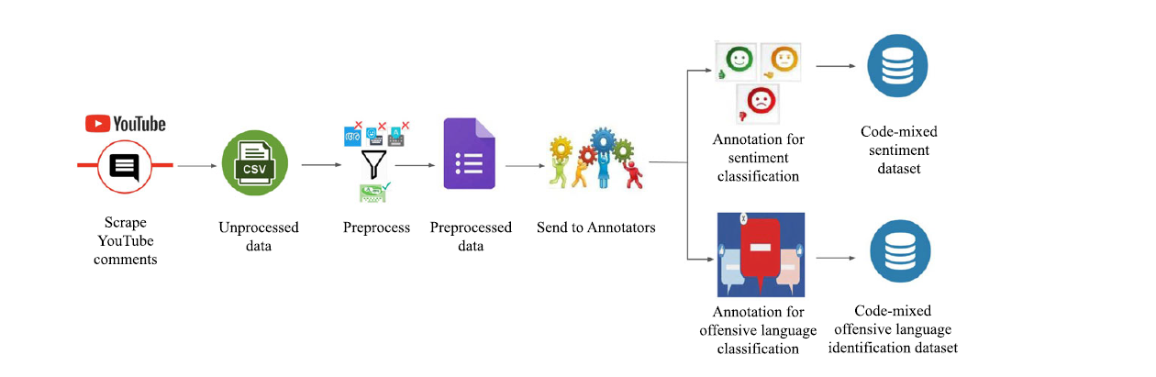

Slide 12
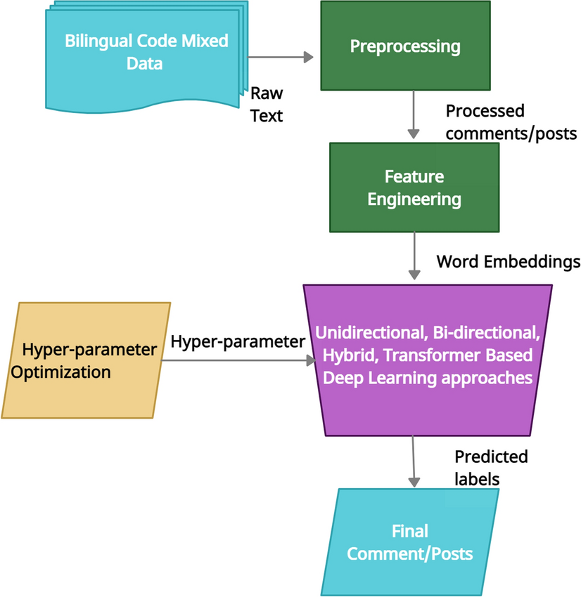
Flow diagram

Slide 13
1.Data collection process
YouTube comment scraping refers to the process of extracting comments from YouTube videos using automated tools or scripts.
This practice is often employed for various purposes, such as sentiment analysis, market research, or gaining insights into audience engagement.
This process is commonly used for data analysis, social research, or content creators seeking feedback.
Developers may create scripts or use specialized tools to gather comments, which can then be analyzed for sentiment, common themes, or engagement patterns.

Slide 14
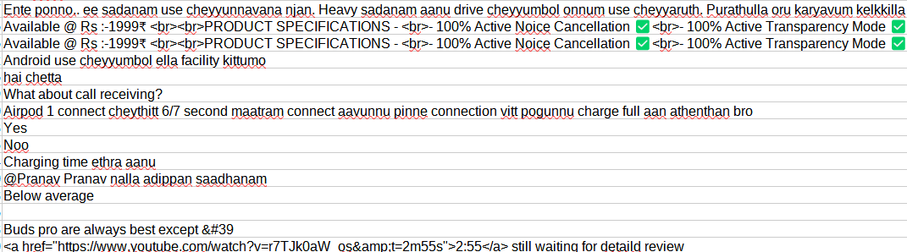
SCRAPER OUTPUT

Slide 15
2.DATA PREPROCESSING
Removal of HTML tags, usernames.
Eliminate special characters, punctuation, and symbols.
Convert all text to lowercase to ensure consistency in text analysis.
Replace emojis with corresponding sentiment labels.
Explore the distribution of reviews, identify common keywords, max. & min. sentence length of texts in the corpus.
Create word clouds or bar charts to visualize the top words or phrases

Slide 16
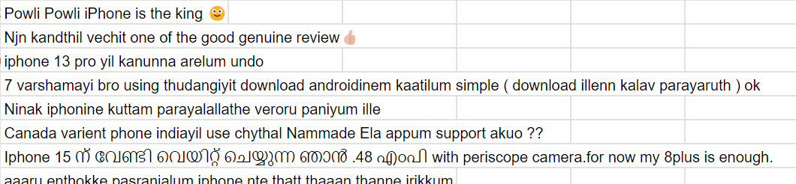
Manglish-Filtered Comment

Slide 17
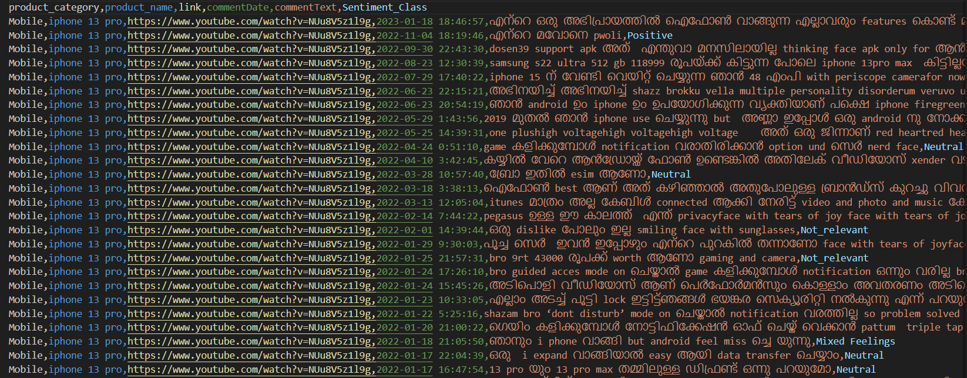
Code-mixed sentiment dataset

Slide 18
3.Model training
Algorithms used:
1.GBM
Gradient Boosting Machine (GBM) is a powerful ensemble learning technique that builds strong predictive models by combining multiple weak learners sequentially. It operates by minimizing errors from the previous model, focusing on the data points that were previously mispredicted, thereby progressively improving accuracy.

Slide 19
2.Linear regression
Fundamental statistical method modeling the relationship between dependent and independent variables.
Assumes a linear relationship to find the best-fitting line minimizing the difference between observed and predicted values.
Widely applied in forecasting, trend analysis, and understanding causal relationships in data analysis.
Linear regression assumes residuals (differences between observed and predicted values) follow a normal distribution, crucial for inference and prediction.
Linear regression allows interpretation of coefficients as measures of the impact of independent variables on the dependent variable, aiding in understanding the direction and magnitude of influence within the linear framework.

Slide 20
3.Naive bayes
Utilizes Bayes' theorem to classify data based on the probability of belonging to a particular class given its features.
Operates under the assumption that features are conditionally independent, simplifying calculations but may not hold true in all scenarios.
Particularly effective with high-dimensional data and relatively smaller datasets due to its simplicity and efficiency.
Widely applied in text classification tasks like spam filtering, sentiment analysis, and document categorization due to its effectiveness with textual data.
Known for its fast training speed, making it suitable for real-time applications and large-scale datasets.

Slide 21
4.Random forest
Utilizes ensemble learning by constructing multiple decision trees during training.
Implements bagging (bootstrap aggregating) by training each tree on a random subset of the dataset with replacement.
Provides feature importance scores based on how much each feature contributes to decreasing impurity or error in the model.
Mitigates overfitting by aggregating predictions from multiple trees, resulting in more generalized models.
Versatile across various tasks and robust against outliers and noise in data due to its ensemble nature.

Slide 22
5.svm
SVMs are powerful supervised learning models primarily used for classification tasks, particularly when dealing with complex, high-dimensional data.
SVM aims to find the optimal hyperplane that best separates different classes in the dataset while maximizing the margin between the classes.
Utilizes the kernel trick to handle non-linear data by mapping it into higher-dimensional spaces, allowing SVMs to effectively handle non-linear relationships.
Focuses on maximizing the margin (distance) between the support vectors (data points closest to the decision boundary), promoting better generalization and resistance to overfitting.
Widely applicable in fields such as text categorization, image recognition, and biological classification due to its robustness and versatility.

Slide 23
6. Bidirectional GRU
Processes sequences both forward and backward for context comprehension.
Uses Gated Recurrent Units (GRUs) for efficient information retention.
Captures long-range dependencies and context from past and future elements.
Commonly applied in NLP tasks like sentiment analysis and machine translation.
Improves learning by combining information from both directions for better sequence modeling.

Slide 24
7. bidirectional LSTM
Handles sequences both forward and backward for context comprehension.
Uses Long Short-Term Memory cells for learning extended dependencies.
Gathers past and future information for comprehensive sequence understanding.
Commonly used in tasks like sentiment analysis and sequence modeling.
Improves comprehension by integrating bidirectional information flow.

Slide 25
8.m-bert
Designed to understand and represent text in multiple languages within a single model.
Employs bidirectional Transformer architecture for contextual word embeddings.
Learns shared representations across various languages, aiding in multilingual tasks.
Widely utilized in natural language processing tasks, enabling language-agnostic applications.
Enhances language understanding and performance in diverse multilingual contexts.

Slide 26
Result and discussion
MODEL | ACCURACY
GBM | 46.06%
LINEAR REGRESSION | 52%
NAIVE BAYES | 46.6%
RANDOM FOREST | 48%
SVM | 52.90%
BiGRU | 41.31%
BiLSTM | 41.16%
M-BERT | 33.08%

Slide 27
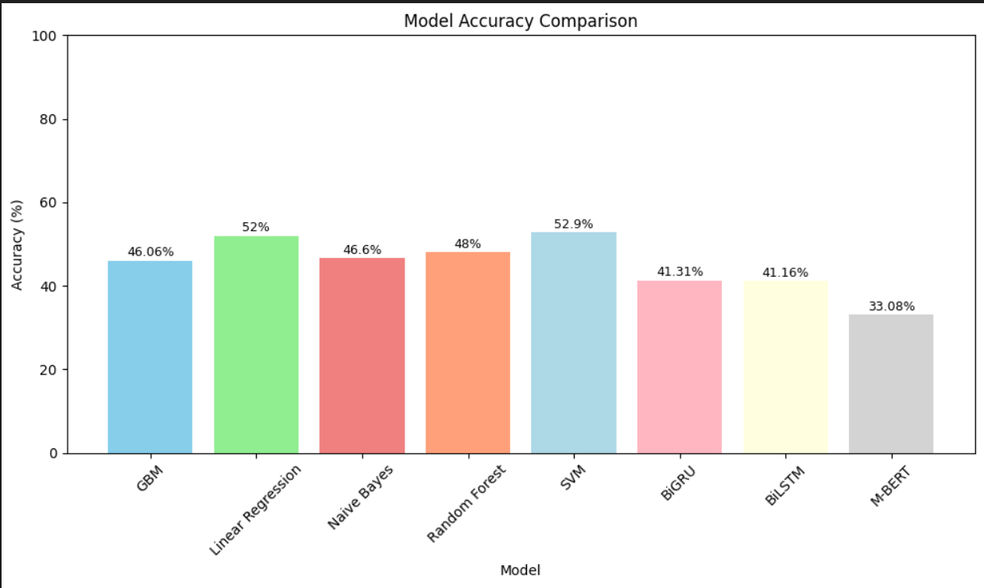

Slide 28
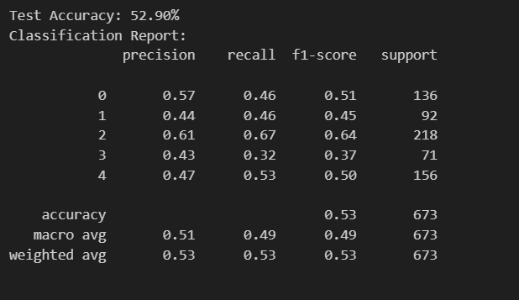
Svm accuracy-52.9%

Slide 29
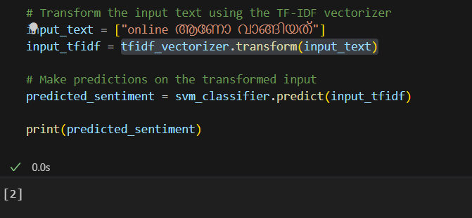
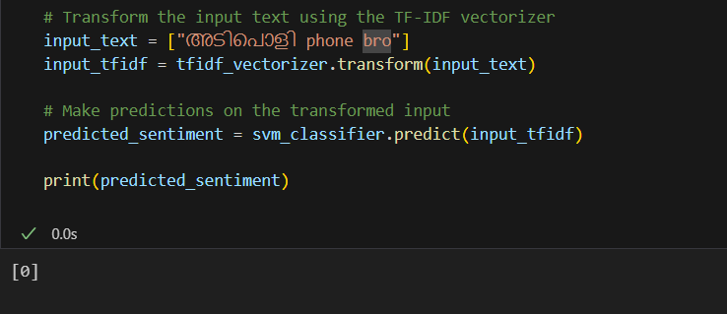
svm –prediction
-not_relevant
Svm –prediction
-positive

Slide 30
Future enhancement
Enhanced Annotation Quality: Improving the precision and detail of annotations can significantly refine model training, potentially leading to increased accuracy across all models.
Inclusion of Code-Mixed Data: Integrating diverse linguistic patterns, especially those involving Roman numerals and English-Malayalam mixes, promises to enrich the dataset. This step is crucial in equipping models to handle multilingual sentiment analysis more effectively.
Acquisition and Annotation of Code-Mixed Content: A dedicated effort to gather and annotate code-mixed data, particularly focusing on English-Malayalam combinations, is essential to broaden the dataset's diversity and improve model performance.

Slide 31
Advanced Preprocessing Techniques: Employing sophisticated preprocessing methods tailored for code-mixed content is critical to effectively leverage this data and ensure models can interpret multilingual text accurately.
Exploration of Hybrid Models: Investigating hybrid models that are adept at handling multilingual text could substantially enhance the accuracy and overall performance of sentiment analysis, especially in diverse linguistic contexts.

Slide 32
conclusion
The project's pioneering effort involved creating a code-mixed dataset within the commercial domain, specifically targeting sentiment analysis in Malayalam. Extensive experimentation with machine learning techniques including GBM, SVM, Naive Bayes, Linear Regression, and deep learning models like BiGRU, BiLSTM, and M-BERT revealed SVM achieving the highest accuracy among the tested models.
Our primary goal was to establish a gold standard code-mixed corpus in Malayalam, enabling sentiment analysis and facilitating offensive language identification, laying the groundwork for multiple machine learning tasks within the commercial domain.

Slide 33
Achieving high accuracy with SVM highlights its strength in decoding complex linguistic nuances within code-mixed Malayalam content. This success not only aids sentiment analysis research but also broadens the potential use of these datasets in various machine learning tasks, significantly expanding their applications in commercial domains.
Our focus remains on enhancing our comprehensive corpus for versatile machine learning applications beyond sentiment analysis. Additionally, we're exploring advanced techniques to better understand code-mixed data, particularly for languages like Malayalam. This aims to advance language processing in underrepresented languages within commercial contexts

Slide 34

Thank you
HRISHIRAJ G L

